Slide 1
Disaster simulation & Safety Management
陳上奎
吳珈澂
Instructor : 黃世強

Slide 2
reminder of our project
Game Engine - Ogre
Motivation
Map creation
Crowd simulation
Fire simulation
Path finding
Disaster escape
Effect & music producing

Slide 3

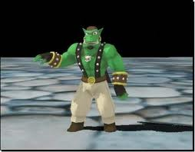
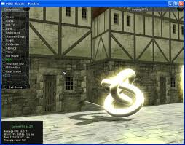
Graphics Rendering Engine - Ogre
OGRE (Object-Oriented Graphics Rendering Engine) is a scene-oriented, real-time, flexible 3D rendering engine (as opposed to a game engine) written in C++ designed.

Slide 4
Motivation
Disaster is unexpected so we hope to create a system to help people when it happens
Mention security of a place by our system map and crowd simulation and disaster simulation
Create a disaster simulation which can help people to escape more quickly when a real disaster take place.

Slide 5
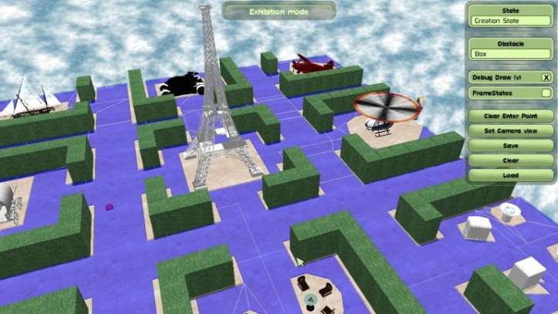
Map creation

Slide 6
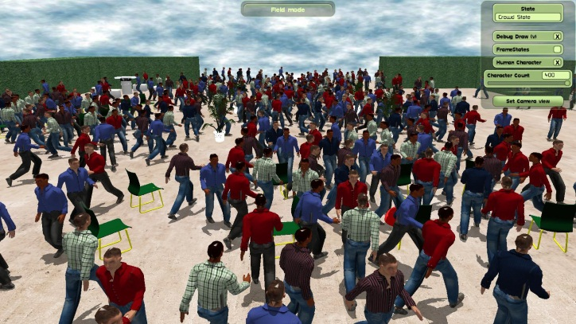
Crowd simulation

Slide 7
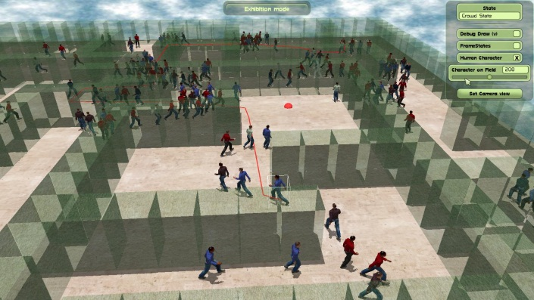
Path finding

Slide 8
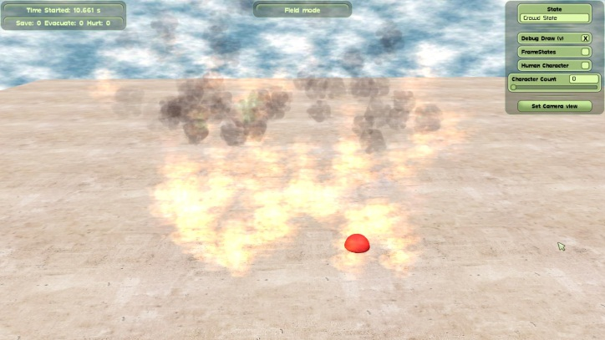
Fire simulation

Slide 9
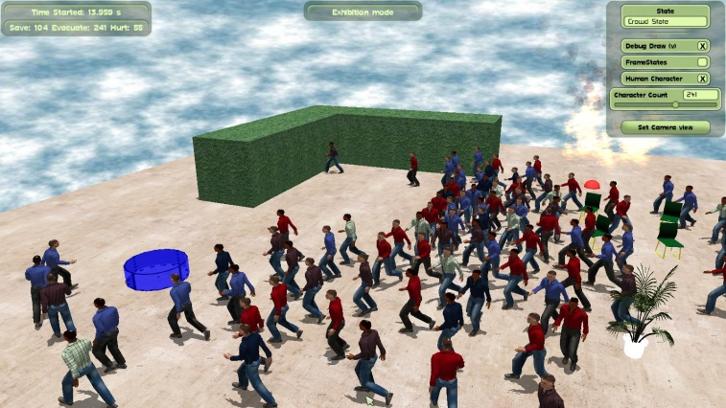
Disaster escape

Slide 10
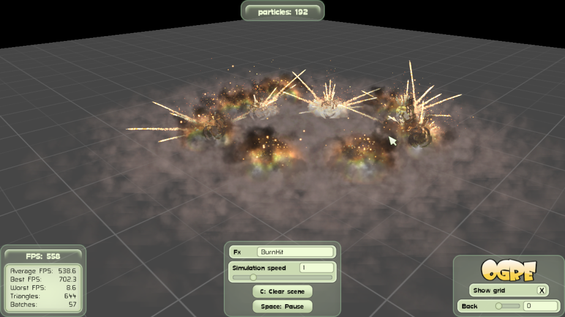
Effect & music producing

Slide 11
Our future goal
Extend from a plane to a building
Make our simulation more vivid and more real.
Add more disasters simulation
Extend the map to other portable device to help people get the map of the construction of the building ;besides, they can escape from the disaster as soon as possible.

Slide 12
Reference
http://www.ogre3d.org/forums/viewtopic.php?f=11&t=70299
Crowd of Virtual Humans: a New Approach for Real Time Navigation in Complex and Structured
http://www.ogre3d.org/forums/viewtopic.php?f=11&t=57487
Path Finding and Collision Avoidance in Crowd Simulation
Indicative Routes for Path Planning and Crowd Simulation

